Slide 1

Business Community Directory
Connect people with local businesses
BCD

Slide 2

Purpose
Key points:
Discover Local Businesses
Community Building
Support Local Economy
Business Visibility and Management
User Reviews and Ratings
Enhanced User Experience
BCD is designed to serve multiple interconnected functions that benefit both users and local businesses.

Slide 3
Key Features
Business Listings
Businesses can create and manage profiles, including contact details, operating hours, and photos.
Search Functionality
Users can search for businesses by name, category, location, or keyword with filtering options.
User Reviews and Ratings
Users can write reviews and give ratings for businesses, and there's a system to check if they're appropriate.
Interactive Map
Integrate a map to display business locations, allowing users to click on markers for details.
User Accounts
Users can create accounts to manage their reviews, save favorites, and receive recommendations.
Admin Dashboard
Admins can manage business listings, moderate reviews, and generate reports.

Slide 4
Technologies
Utilized a client-server architecture to develop the application, employing the following technologies:
Frontend
Backend
SPA ~ Angular / React.
JavaScript framework: A powerful framework for building dynamic single-page applications (SPAs) with a modular architecture.
Node.js with Express.
Node.js: Enables JavaScript to be used on the server side, facilitating a full-stack JavaScript application.
Express: A web application framework for Node.js, providing robust features for building RESTful APIs.
Database
RDBMS.
PostgreSQL: A powerful relational database management system, ideal for handling complex queries and ensuring data integrity

Slide 5


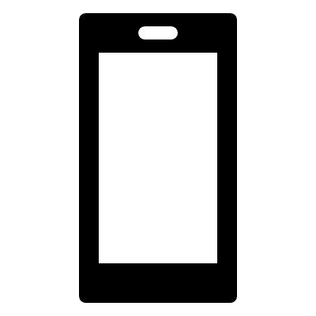


Thank You
Zeeshan Rais
+358 41 729 8802
zeeshan.rais@student.lut.fi
Full Stack Development

